Slide 1

Ozone layer depletion; Acid rain; Natural disasters and human population growth
Information Security Fundamentals | Climate Change (Impacts, Adaptation and Mitigation)
Course: Information Security Fundamentals | Chapter: Climate Change (Impacts, Adaptation and Mitigation) | Program: Bachelor of Engineering
DISCOVER · LEARN · EMPOWER
Notes:
Welcome to today's lecture on critical environmental challenges within our climate change framework. We will specifically analyze ozone depletion, acid rain, and the compounding effects of natural disasters driven by population growth. These topics are essential for understanding the real-world impacts we face today.

Slide 2
Course Outcomes
SLIDE 2 / 14
Course Outcome
CO | BT LEVEL | DESCRIPTION
CO1 | BT4 | Recall, analyze and respond on fundamental environmental principles, such as ecological relationships and conservation strategies
CO2 | BT4 | Understand and analyze the interconnections between human activities and environmental impacts across different ecosystems
CO3 | BT4 | Understand and analyze and apply environmental laws and policies to analyse and propose solutions for real-world environmental challenges.
CO4 | BT2 | Students will analyse data from environmental monitoring programs to assess trends and predict future impacts on ecosystems.
CO5 | BT6 | Interpret, elaborate and propose various tools, design and innovative strategies for sustainable development and environmental conservation initiatives in securing the planet.
Chandigarh University
2 / 14
Notes:
This lecture directly addresses Course Outcome 3, which requires you to analyze and apply environmental laws to real-world challenges. We will examine how policies address ozone depletion and acid rain to propose viable solutions. Understanding these mechanisms is crucial for your future engineering practice.

Slide 3
Learning Objectives
SLIDE 3 / 14
Learning Outcomes
1
Analyze the chemical mechanisms causing stratospheric ozone layer depletion globally.
2
Evaluate the formation process and ecological impacts of acid rain on ecosystems.
3
Assess the correlation between rapid human population growth and natural disaster frequency.
4
Apply mitigation strategies to reduce the severity of ozone and acid rain effects.
5
Propose policy solutions for managing population-driven environmental risks effectively.
Chandigarh University
3 / 14
Notes:
By the end of this session, you will be able to analyze the specific chemical reactions depleting our ozone layer. You will also evaluate how acid rain forms and assess the direct link between population growth and disaster intensity. Finally, we will apply mitigation strategies to propose concrete policy solutions.

Slide 4
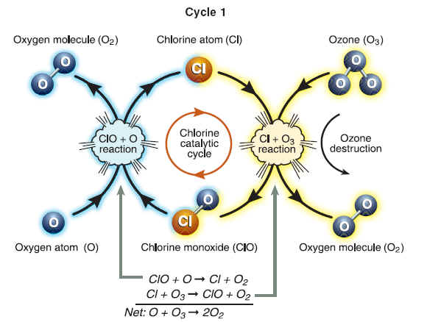
Lecture
SLIDE 4 / 14
Ozone Depletion Mechanism
1
Ozone depletion occurs when chlorine and bromine atoms destroy ozone molecules in the stratosphere.
2
Chlorofluorocarbons (CFCs) release chlorine atoms upon exposure to ultraviolet radiation in the upper atmosphere.
3
One chlorine atom can destroy over 100,000 ozone molecules through a catalytic cycle.
4
The Antarctic ozone hole forms due to unique polar stratospheric cloud conditions in winter.
5
Depletion increases surface ultraviolet radiation, causing higher rates of skin cancer and cataracts.
The Ozone Hole
Chandigarh University
4 / 14
Notes:
Think of the ozone layer as a shield that absorbs harmful UV radiation. When CFCs reach the stratosphere, UV light breaks them apart, releasing chlorine atoms. These atoms act as catalysts, destroying ozone without being consumed themselves. A single chlorine atom can destroy over 100,000 ozone molecules, making this a severe threat.

Slide 5
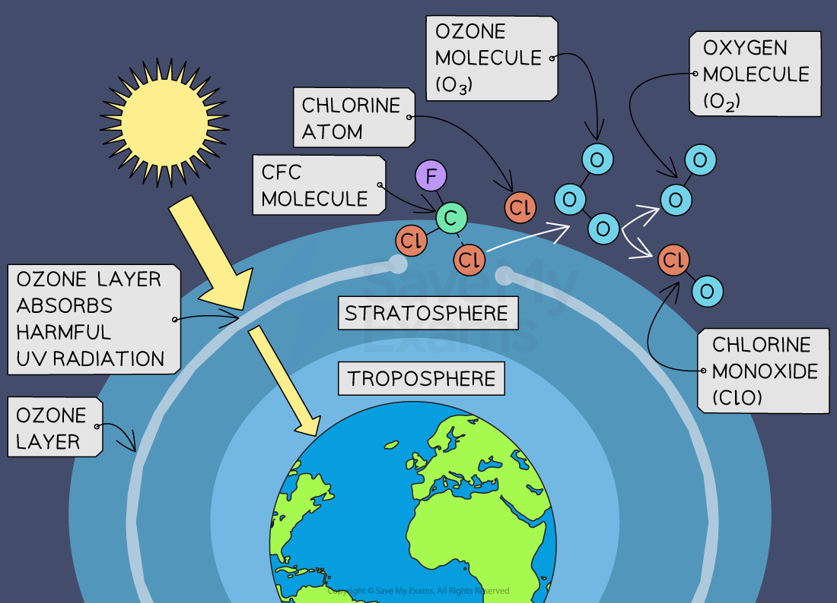
Lecture
SLIDE 5 / 14
Acid Rain Formation Process
1
Acid rain forms when sulfur dioxide and nitrogen oxides react with water vapor in the atmosphere.
2
Sulfur dioxide converts to sulfuric acid, while nitrogen oxides convert to nitric acid in clouds.
3
Primary sources include coal-fired power plants and vehicles emitting sulfur and nitrogen compounds.
4
The resulting precipitation has a pH level significantly lower than the natural 5.6 baseline.
5
Acid rain leaches essential nutrients from soil and damages aquatic life in lakes and rivers.
Stratospheric Ozone | College Board AP® Environmental Science Revision Notes 2020 (source: cdn.savemyexams.com)
Chandigarh University
5 / 14
Notes:
Acid rain is not just rain; it is precipitation with a pH below 5.6 due to chemical reactions. When sulfur dioxide and nitrogen oxides mix with water vapor, they form strong acids like sulfuric and nitric acid. These acids fall as rain, snow, or fog, leaching nutrients from soil and harming aquatic ecosystems.

Slide 6
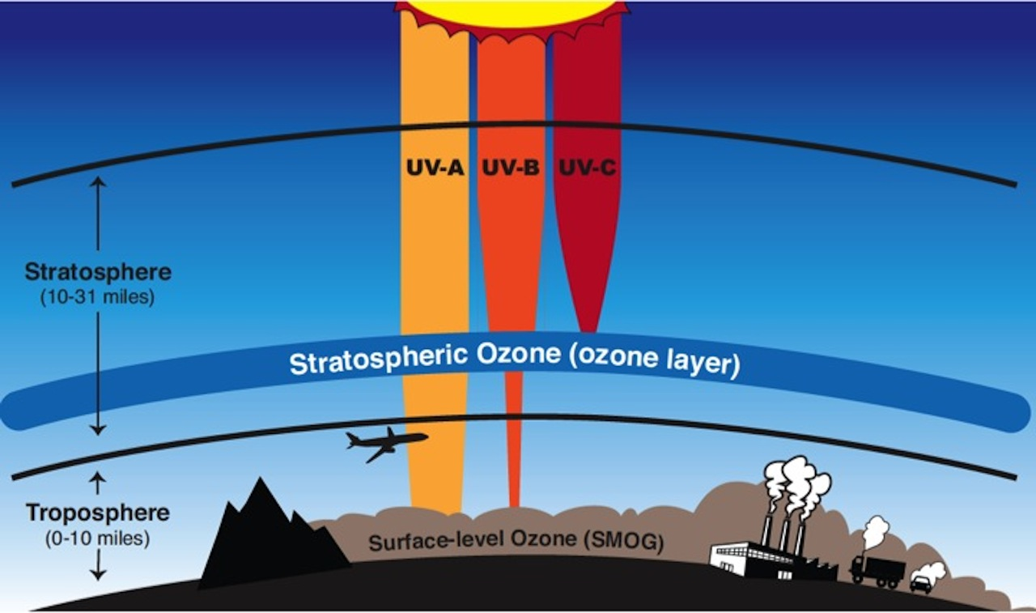
Lecture
SLIDE 6 / 14
Impact of Population Growth
1
Rapid human population growth increases energy demand, leading to higher fossil fuel combustion rates.
2
Urbanization expands impervious surfaces, reducing soil absorption and increasing flood risks during storms.
3
Higher population density concentrates pollution sources, intensifying local acid rain and ozone depletion effects.
4
Resource overconsumption accelerates habitat destruction, reducing nature's capacity to buffer natural disasters.
5
Migration to disaster-prone areas increases the number of people exposed to climate hazards.
10.2 Ozone Depletion – Environmental Biology (source: openoregon.pressbooks.pub)
Chandigarh University
6 / 14
Notes:
Population growth acts as a multiplier for environmental stress. As more people demand energy, fossil fuel combustion rises, worsening acid rain and ozone depletion. Urbanization also reduces soil absorption, making floods more severe. Essentially, more people mean more pollution and greater exposure to natural disasters.

Slide 7
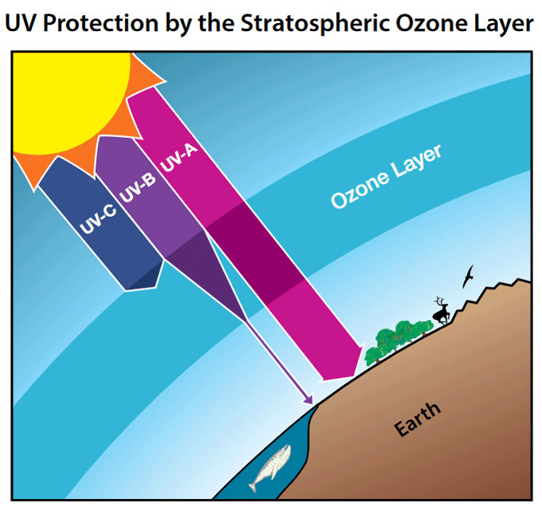
Lecture
SLIDE 7 / 14
Natural Disaster Amplification
1
Climate change intensifies natural disasters like hurricanes, floods, and droughts through rising temperatures.
2
Warmer oceans provide more energy for tropical cyclones, increasing their intensity and rainfall.
3
Glacial melting and thermal expansion contribute to rising sea levels, exacerbating coastal flooding.
4
Droughts become more frequent and severe, leading to water scarcity and agricultural failures.
5
Human settlements in vulnerable zones face higher risks due to inadequate infrastructure planning.
Health and Environmental Effects of Ozone Layer Depletion | US EPA (source: www.epa.gov)
Chandigarh University
7 / 14
Notes:
Natural disasters are becoming more frequent and intense due to climate change. Warmer oceans fuel stronger hurricanes, while melting glaciers raise sea levels, worsening coastal flooding. Droughts are also becoming more severe, threatening water supplies and agriculture. These changes amplify the risks for human populations living in vulnerable areas.

Slide 8
Worked Example
SLIDE 8 / 14
Ozone Loss
CALCULATION
300 × 0.7374 ≈ 221.2 DU, representing a loss of 78.8 DU.
• Assume a region loses 3% of its ozone layer annually due to CFC emissions.
• Initial ozone concentration is 300 Dobson Units (DU) in the year 2000.
• After 10 years, the remaining ozone is calculated as 300 × (0.97)^10.
• This 26% total loss significantly increases UV-B radiation reaching the Earth's surface.
Stratospheric Ozone | College Board AP® Environmental Science Revision Notes 2020 (source: cdn.savemyexams.com)
Chandigarh University
8 / 14
Notes:
Let's calculate the impact of a 3% annual loss. Starting with 300 Dobson Units, we apply the decay formula: 300 × (0.97)^10. This results in approximately 221 DU after 10 years. This represents a 26% total loss, which drastically increases the UV radiation reaching the surface, posing serious health risks.

Slide 9
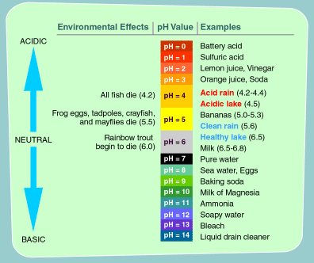
Worked Example
SLIDE 9 / 14
Acid Rain pH
CALCULATION
10^1.6 ≈ 39.8, meaning the acid rain is nearly 40 × more acidic.
• Normal rain has a pH of 5.6 due to dissolved carbon dioxide forming weak carbonic acid.
• Acid rain with a pH of 4.0 contains 10 × more hydrogen ions than normal rain.
• A drop from pH 5.6 to 4.0 increases acidity by a factor of 10^(5.6-4.0).
• This high acidity dissolves limestone statues and kills fish in sensitive aquatic environments.
Source: www3.epa.gov
Chandigarh University
9 / 14
Notes:
The pH scale is logarithmic, meaning small changes represent large differences in acidity. Normal rain is pH 5.6, but acid rain can drop to 4.0. The difference is 1.6 units, which means the acid rain is 10^1.6 × more acidic, or about 40 × stronger. This explains why even slight pH drops cause severe damage to ecosystems.

Slide 10

Lecture
SLIDE 10 / 14
Common Pitfalls in Analysis
1
Confusing weather patterns with long-term climate trends leads to incorrect impact assessments.
2
Ignoring the catalytic nature of ozone depletion underestimates the long-term damage potential.
3
Attributing all natural disasters solely to climate change without considering population density factors.
4
Overlooking the role of international treaties like the Montreal Protocol in recovery efforts.
5
Failing to distinguish between natural acid rain and anthropogenic acid rain sources.
Source: static.vecteezy.com
Chandigarh University
10 / 14
Notes:
A common mistake is confusing short-term weather with long-term climate trends. Another pitfall is ignoring the catalytic nature of ozone depletion, which means one molecule causes massive damage. We must also distinguish between natural and anthropogenic acid rain sources to propose effective solutions.

Slide 11
Mitigation Strategies
SLIDE 11 / 14
Ozone
1
The Montreal Protocol successfully phased out CFCs, leading to a gradual recovery of the ozone layer.
2
Transitioning to hydrofluorocarbons (HFCs) as safer alternatives reduces ozone-depleting potential significantly.
3
Strict regulations on industrial emissions prevent the release of new ozone-depleting substances.
4
Public awareness campaigns educate consumers on avoiding products containing ozone-depleting chemicals.
5
International cooperation ensures compliance and monitoring of ozone recovery progress globally.
10.2 Ozone Depletion – Environmental Biology (source: openoregon.pressbooks.pub)
Chandigarh University
11 / 14
Notes:
The Montreal Protocol is a prime example of successful international cooperation. By phasing out CFCs, we have seen the ozone layer begin to recover. Transitioning to safer alternatives like HFCs is crucial. Public awareness and strict regulations ensure that we continue to protect this vital atmospheric shield.

Slide 12
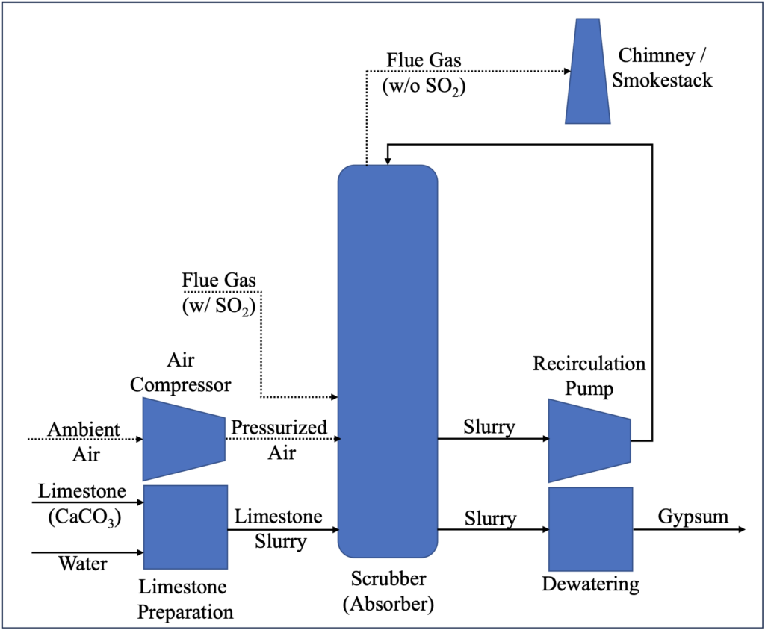
Mitigation Strategies
SLIDE 12 / 14
Acid Rain
1
Flue gas desulfurization units remove sulfur dioxide from power plant emissions before release.
2
Catalytic converters in vehicles reduce nitrogen oxide emissions, lowering acid rain precursors.
3
Switching to renewable energy sources like wind and solar eliminates fossil fuel combustion.
4
Liming lakes and soils neutralizes existing acidity, restoring pH levels for aquatic life.
5
Energy efficiency programs reduce overall fuel consumption, decreasing total pollutant emissions.
Source: www.long-intl.com
Chandigarh University
12 / 14
Notes:
To combat acid rain, we use technologies like flue gas desulfurization to remove sulfur dioxide from power plants. Catalytic converters in vehicles reduce nitrogen oxides. Switching to renewable energy is the ultimate solution, as it eliminates fossil fuel combustion. Liming lakes can also neutralize existing acidity to restore ecosystems.

Slide 13
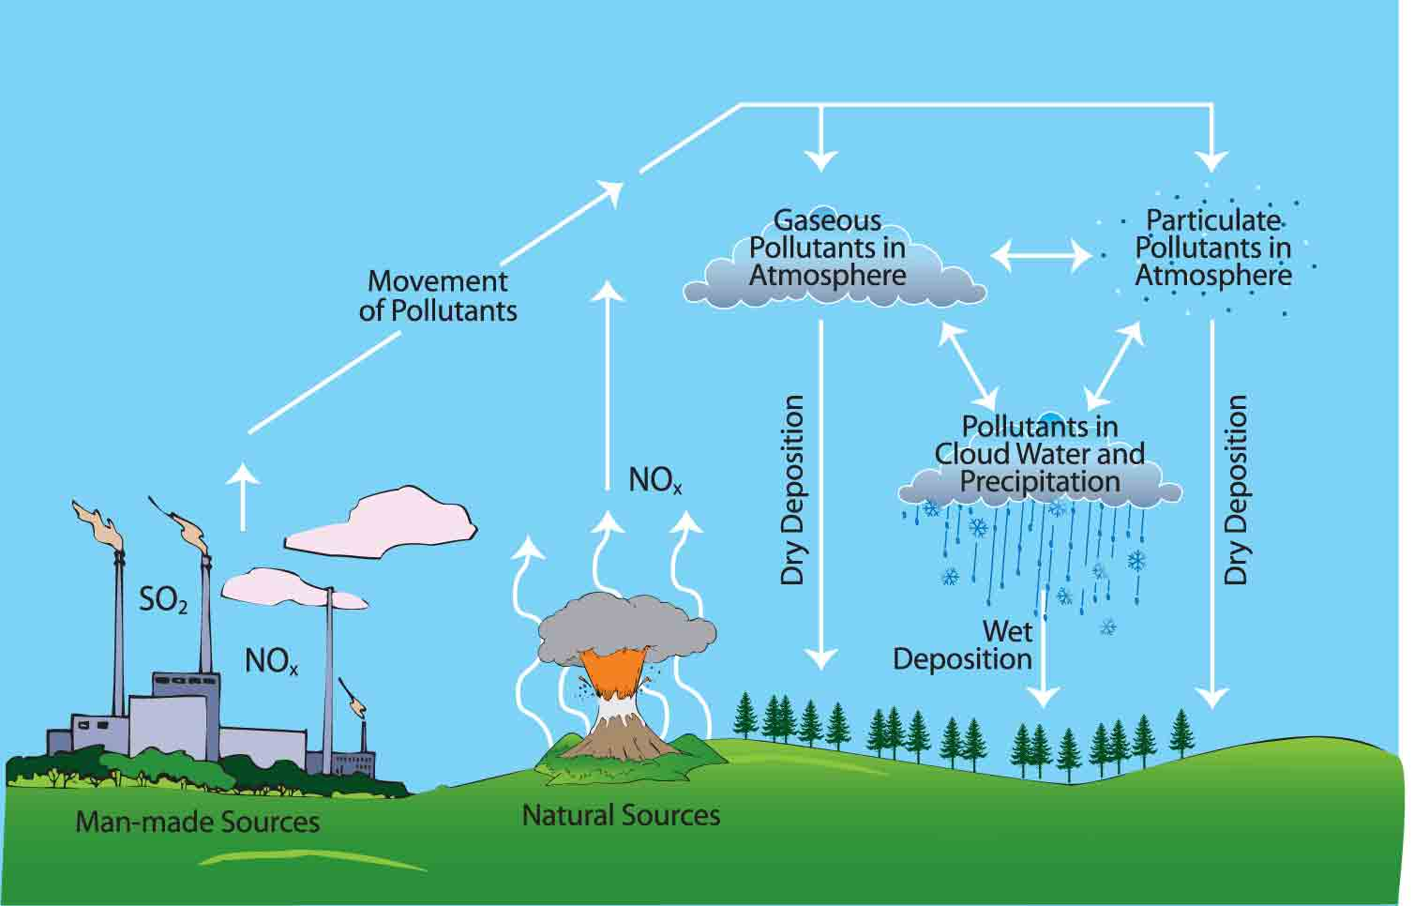
Lecture
SLIDE 13 / 14
Key Takeaways
1
Ozone depletion is driven by catalytic cycles involving chlorine from CFCs, causing severe UV exposure.
2
Acid rain results from sulfur and nitrogen oxides, creating highly acidic precipitation that harms ecosystems.
3
Human population growth amplifies natural disasters by increasing pollution and exposure in vulnerable zones.
4
Mitigation requires international treaties, technological innovation, and a shift to renewable energy sources.
5
Understanding these mechanisms is essential for applying environmental laws to propose real-world solutions.
Source: www.setimanitoba.org
Chandigarh University
13 / 14
Notes:
In summary, ozone depletion and acid rain are critical environmental challenges driven by human activity. Population growth exacerbates these issues and increases the frequency of natural disasters. Mitigation requires international cooperation, technological innovation, and a shift to renewable energy. Understanding these mechanisms is key to applying environmental laws effectively.

Slide 14
Lecture
SLIDE 14 / 14
References
ENVIRONMENTAL STUDIES
From Crisis to Cure — R. Rajagopalan
• Environmental Science and Engineering — Benny Joseph
• Environmental Studies — R.C. Sharma and D. Gurbir Sangha
• Introduction to Environmental Science — Anjaneyulu, Y.
• Environmental Pollution Control Engineering — C.S. Rao
• Textbook of Environmental Studies for undergraduate courses — E. Bharucha
• Environmental Science — S.C. Santra
Chandigarh University
14 / 14
Notes:
These references provide the foundational knowledge for the topics discussed today. They cover environmental laws, pollution control, and the scientific principles behind climate change impacts. I encourage you to consult these texts for deeper insights into the case studies and policies we reviewed.

